Slide 1
Emergency Vehicle Traffic Avoidance
Reinforcement Learning Project
Bikram Karki
University of Memphis

Slide 2
Introduction
Traffic dynamics is notoriously complex
In 2020, an estimated 42,060 people lost their lives to car crashes in US and 4.8 million people injured seriously (National Safety Council)
Government data identifies driver behavior or error as a factor in 94 percent of crashes
Higher levels of autonomy have the potential to reduce risky and dangerous driver behaviors

Slide 3
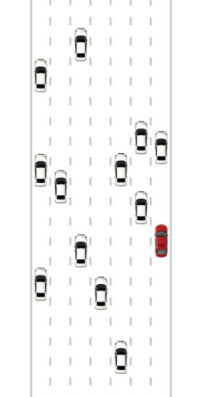
Project Idea
Implementation of an autonomous vehicle (AV)surrounded by other vehicles in a dense highway traffic
AV will try to beat the traffic to reach from a source to destination
very helpful to top priority vehicles such as ambulances, firefighters, police, and other emergency vehicles

Slide 4
RL formulation
Environment
SUMO environment with 4 lane highway with 22 vehicles
Agent : Autonomous Vehicle
Actions :
Accelerate
Decelerate
Change into left lane
Change into right lane
No lane change
States:
Position and Speed of Vehicles
Position and speed of neighboring vehicles

Slide 5
RL formulation
Goal : Beat traffic and Cover distance as possible in a given time
Reward :
-20 on crash
Distance covered/ velocity achieved

Slide 6
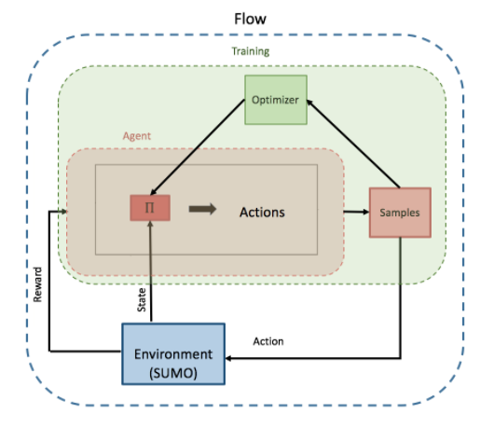
Tools
Flow
an open-source deep reinforcement learning framework for mixed autonomy traffic
Mobile Sensing Lab, University of California Berkeley
SUMO
an open-source traffic simulation suite designed to handle road networks
mainly developed by employees of the Institute of Transportation Systems at the German Aerospace Center

Slide 7
Algorithm
Proximal Policy Optimization (OpenAI 2017)
A policy gradients method

Slide 8
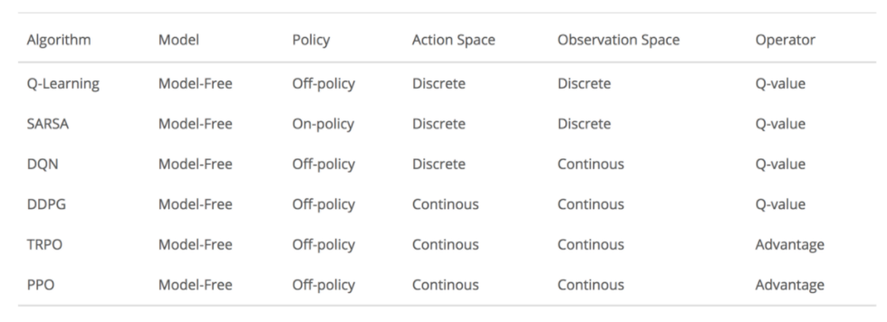
Algorithm
Proximal Policy Optimization (OpenAI 2017)
A policy gradients method

Slide 9
PPO
Advantage is an estimate how an action is compared to the average action for a specific state
Unstable policy update
Large step size → Bad policy
Next batch is generated from correct bad policy → collect bad samples
Bad samples → worst policy
Small step size → learning process slow
Idea of PPO is to estimate a trust region where we can safely take reasonable steps in right direction

Slide 10
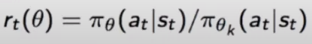
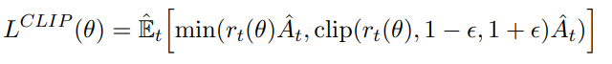
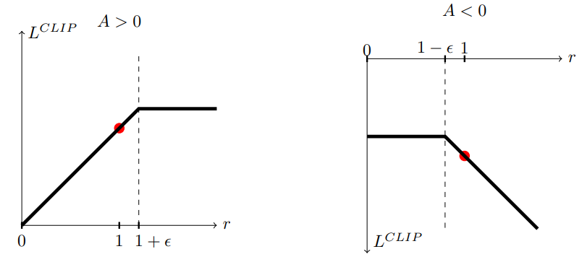
PPO
Define a ratio between current policy and older policy
Define a new objective function to determine how much to deviate from the old policy
To optimize that clips the estimated advantage function if the new policy is far away from the old policy
If the probability ratio falls outside the range of (1-ε) and (1+ ε), the advantage function will be clipped
Discourages any large policy changes when the ratio of our
current policy and old policies falls outside our comfort zone

Slide 11
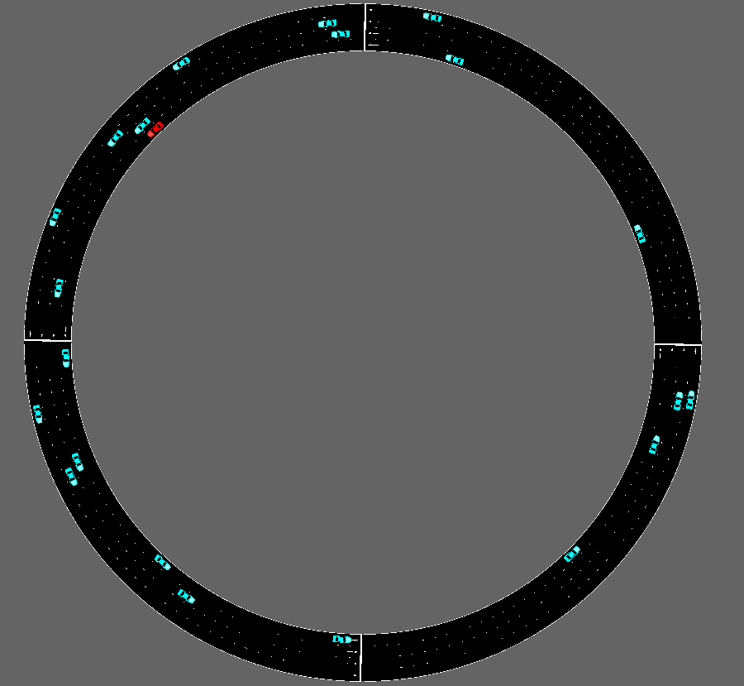
Experiment Setting
Ring length : 500m
Randomly generated vehicle positions
Agent max acceleration/deceleration : 5/-5 ms²

Slide 12
Hyperparameters
Horizon = 1500
Gamma = 0.99
Hidden layers = 16,16,16
Use_gae : generalized advantage estimation True
GAE Lambda = 0.97
Kl_target = 0.02
Train_batch_size = Horizon * num_rollouts
Number of SGD iterations = 10
Learning rate = 0.001
Entropy_coefficient : 0
Clip param : 0.3

Slide 13
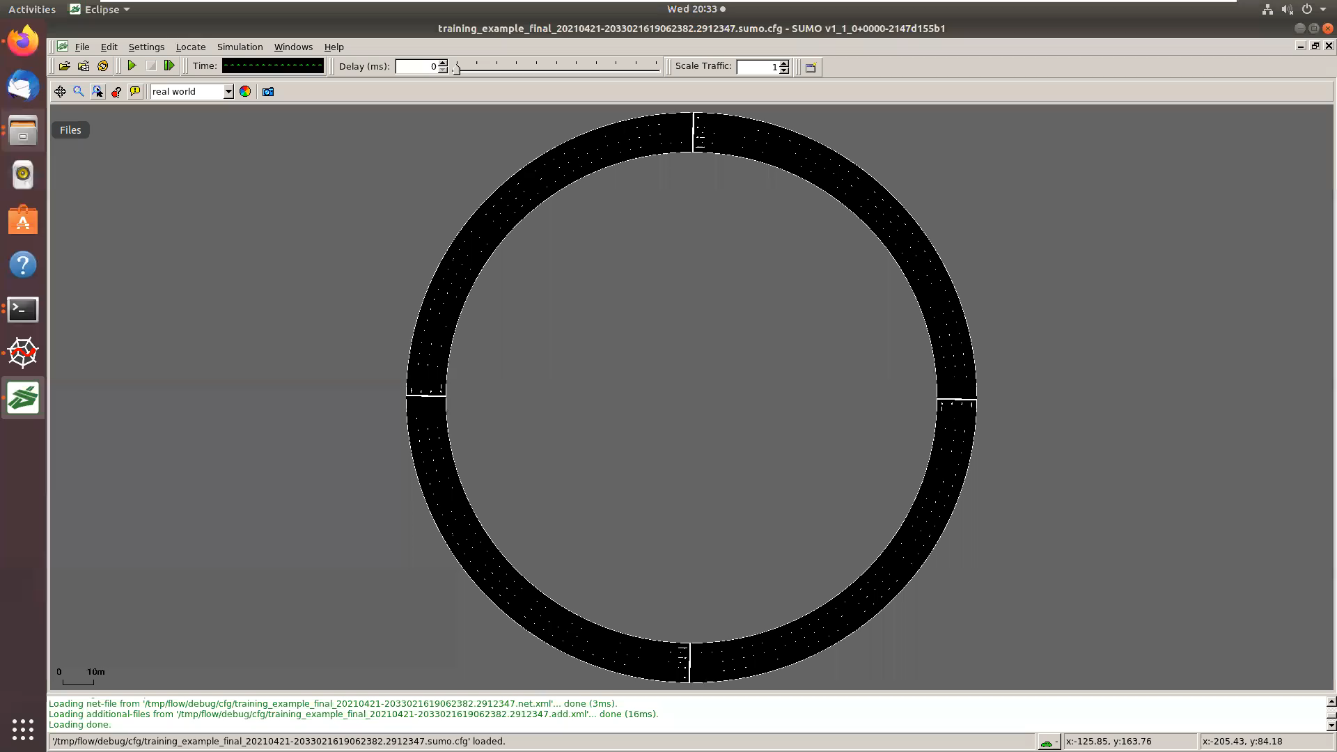
Demo PO

Slide 14
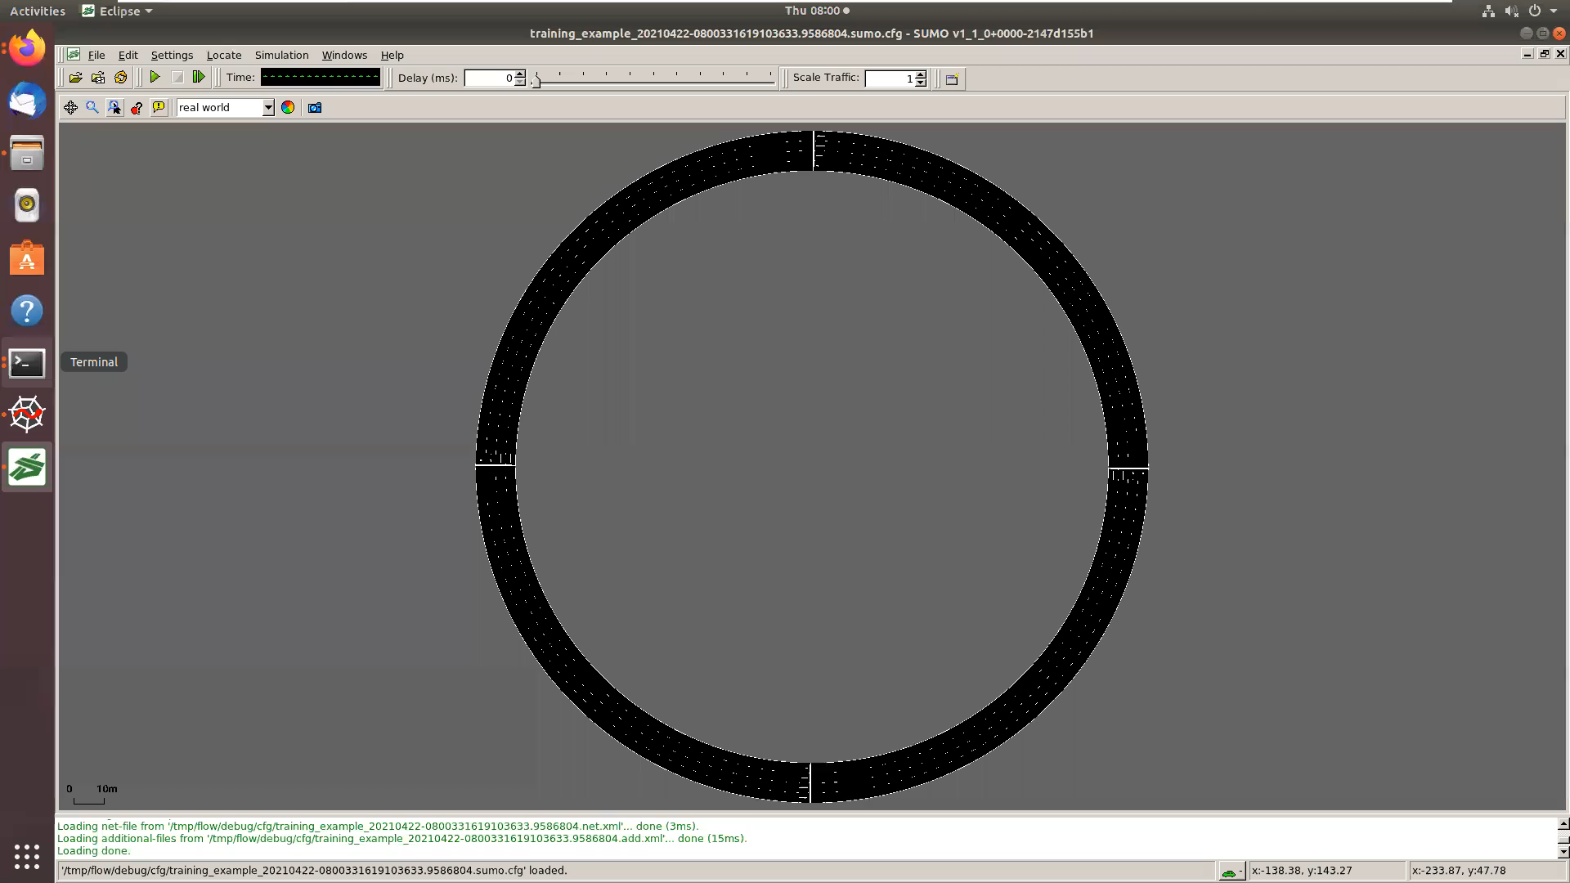
Demo FO

Slide 15
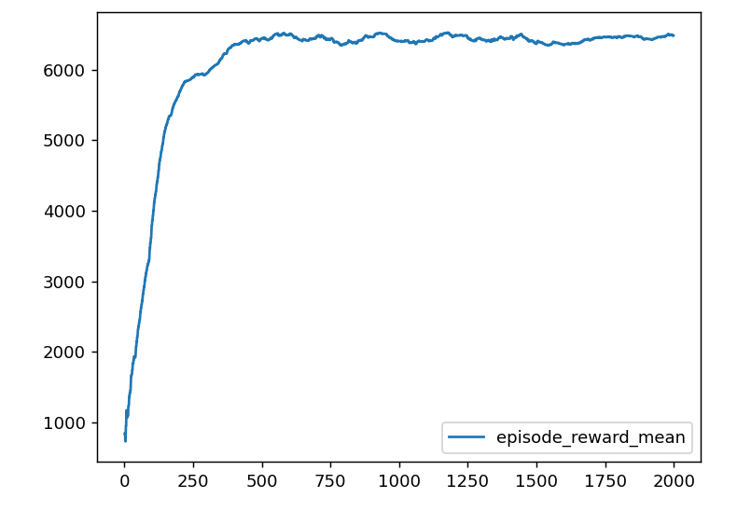
Result
Reward: Distance covered in each iteration in fully observable

Slide 16
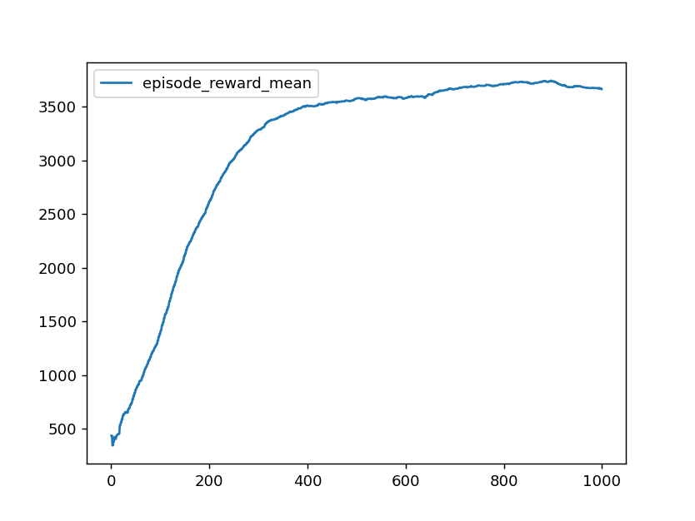
Result
Reward: Distance covered in each iteration in partially observable

Slide 17
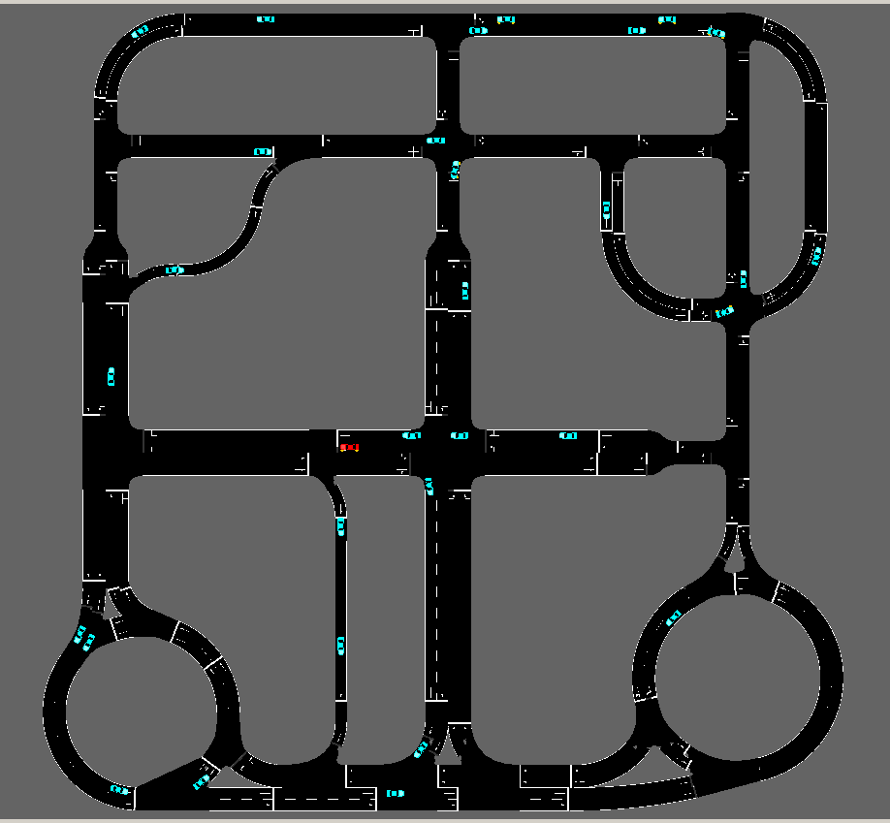
Future Work
Large networks

Slide 18
Thank you!

